Slide 1
BONE DEFORMITY IDENTIFICATION USING MACHINE LEARNING
VISHNU.K
MES20MCA-2059
PRODUCT OWNER –NOWSHAD.CV

Slide 2
TABLE OF CONTENTS
Introduction
Modules
Data Flow Diagram
Table Design
Developing Environment
Product Backlog
User Stories
Project Plans
Sprint Plans
Sprint Actual

Slide 3
INTRODUCTION
The success of machine learning algorithms in medical imaging has increased the need for artificially trained models to make them work in the medical field more quickly and efficiently. This paper gives a technique to identify bone fracture using machine learning algorithms, by which workload for orthopedics can be reduced. The significant use of machine learning in this era of big medical data would help gather information from the available x-ray images rather than spending hours in the radiology departments. This Project presents imaging technologies used to identify bone fracture in the human body and give quick results once the x-ray has been taken. The Main Modules are Admin and user.

Slide 4
MODULES
ADMIN
Login
Data set management
View users
Feedbacks
View prediction results
USER
Register
Login
Upload image
View prediction
Feedback

Slide 5
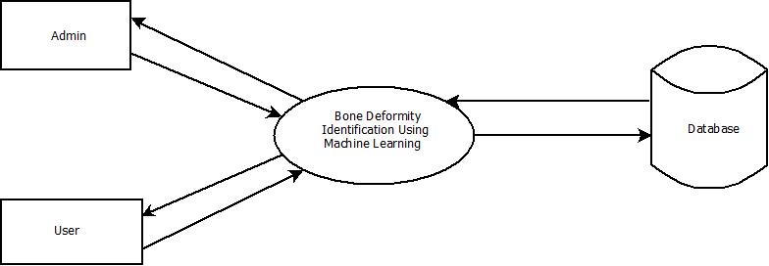
DATA FLOW DIAGRAM
LEVEL-0

Slide 6
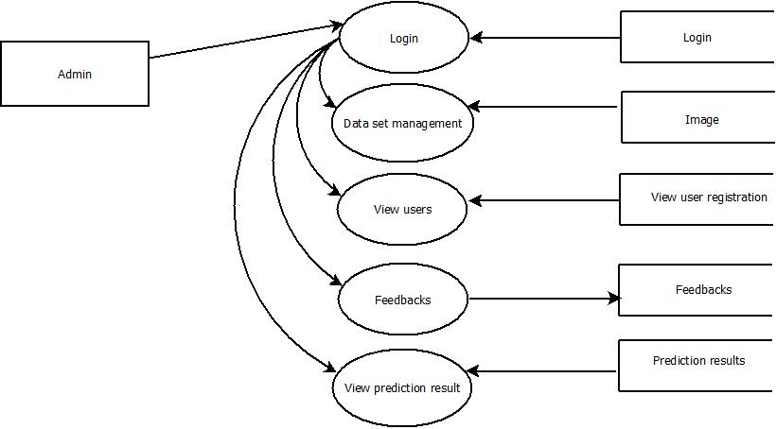
LEVEL-1.1

Slide 7
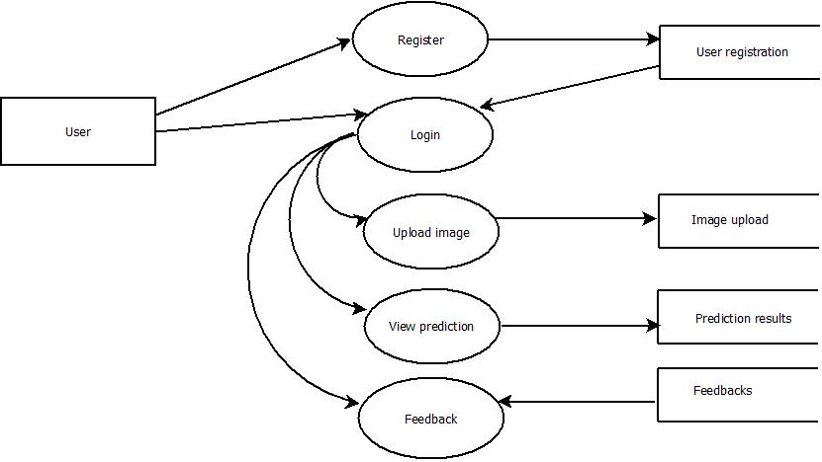
LEVEL-1.2

Slide 8
DEVELOPING ENVIRONMENT
Hardware Requirements
Input Device :Mouse , Keyboard
Output Device :Monitor
Memory :3 Gb(Minimum)
Processor :Intel Pentium Core i3 and above, 64 bits
Software Requirements
Operating System :WINDOWS 10(Better Performance)
Front End :Html,Css,JavaScript
Back End :Mysql
IDE Used :JetbrainsPycharm,Android studio
Technology Used :Python,Java
Frame Work Used :Flask

Slide 9
PRODUCT BACKLOG
User Story ID | Priority <High/Medium/Low> | Size (Hours) | Sprint <#> | Status <Planned/In progress/Completed> | Release Date | Release Goal
1 | Medium | 2 | 1 | Completed | 08/01/2022 | Table design
2 | High | 3 |  | Completed | 08/01/2022 | Form design
3 | High | 5 |  | Completed | 08/01/2022 | Basic coding
3 | High | 5 | 2 | Planned |  | Creation data set
4 | Medium | 5 |  | Planned |  | Preprocessing
5 | High | 5 | 3 | Planned |  | Training
6 | medium | 5 |  | Planned |  | Prediction
7 | Medium | 5 | 4 | Planned |  | Testing data
8 | High | 5 |  | Planned |  | Output generation

Slide 10
USER STORY
UserStoryID | As a <type of user> | I want to | So that I can
1 | Admin | login | login successful with correct username and password
2 | Admin | view user | view users
3 | Admin | view feedback | view users feedback

Slide 11
PROJECT PLAN
User Story ID | Task Name | Start Date | End Date | Days | Status
1 | Sprint 1 | 26/12/2021 | 28/12/2021 | 2 | Completed
2 |  | 29/12/2021 | 31/12/2021 | 3 | Completed
3 |  | 03/01/2022 | 08/01/2022 | 5 | Completed
4 | Sprint 2 | 09/01/2022 | 16/01/2022 | 8 | Planned
5 |  | 18/01/2022 | 22/01/2022 | 5 | Planned
6 | Sprint 3 | 23/01/2022 | 27/01/2022 | 5 | Planned
7 |  | 30/01/2022 | 05/02/2022 | 7 | Planned
8 | Sprint 4 | 06/02/2022 | 10/01/2022 | 5 | Planned
9 |  | 16/02/2022 | 19/02/2022 | 4 | Planned

Slide 12
SPRINT BACKLOG
Backlog Item | Status & completion date | Original estimate in hours | Day1 | Day2 | Day3 | Day4 | Day5 | Day6 | Day7 | Day8 | Day9 | Day10 | Day11 | Day12 | Day13 | Day14
User story #1,#2,#3,#4 |  | hrs | hrs | hrs | hrs | hrs | hrs | hrs | hrs | hrs | hrs | hrs | hrs | hrs | hrs | hrs
Table design | 28/12/2021 | 2 | 1 | 1 | 0 | 0 | 0 | 0 | 0 | 0 | 0 | 0 | 0 | 0 | 0 | 0
Form design | 31/12/2021 | 3 | 0 | 0 | 0 | 1 | 1 | 1 | 0 | 0 | 0 | 0 | 0 | 0 | 0 | 0
Coding | 08/01/2021 | 5 | 0 | 0 | 0 | 0 | 0 | 0 | 0 | 0 | 0 | 1 | 1 | 1 | 1 | 1
User story #5,#6,#7,#8
Scan files | 16/01/2022 | 5 | 1 | 1 | 0 | 1 | 0 | 1 | 0 | 1 | 0 | 0 | 0 | 0 | 0 | 0
Text –to-speech | 22/01/2022 | 5 | 0 | 0 | 0 | 0 | 0 | 0 | 0 | 0 | 0 | 1 | 1 | 1 | 1 | 1
Speech-to-text | 27/01/2022 | 5 | 1 | 1 | 1 | 1 | 1 | 0 | 0 | 0 | 0 | 0 | 0 | 0 | 0 | 0
Save files | 05/02/2022 | 5 | 0 | 0 | 0 | 0 | 0 | 0 | 0 | 1 | 0 | 1 | 1 | 1 | 0 | 1
Testing data | 10/01/2022 | 5 | 1 | 1 | 1 | 1 | 1 | 0 | 0 | 0 | 0 | 0 | 0 | 0 | 0 | 0
User story #9
Output generation | 20/02/2022 | 5 | 0 | 0 | 0 | 0 | 0 | 0 | 0 | 0 | 0 | 2 | 1 | 1 | 1 | 1
Total |  | 40 | 4 | 4 | 2 | 4 | 3 | 2 | 0 | 2 | 0 | 5 | 4 | 4 | 3 | 4

Slide 13
SPRINT ACTUAL
Backlog Item | Status & completion date | Original estimate in hours | Day1 | Day2 | Day3 | Day4 | Day5 | Day6 | Day7 | Day8 | Day9 | Day10 | Day11 | Day12 | Day13 | Day14
User story #1,#2,#3,#4 |  | hrs | hrs | hrs | hrs | hrs | hrs | hrs | hrs | hrs | hrs | hrs | hrs | hrs | hrs | hrs
Table design | 28/12/2021 | 3 | 1 | 1 | 0 | 0 | 0 | 0 | 0 | 0 | 0 | 0 | 0 | 0 | 0 | 0
Form design | 31/12/2021 | 2 | 0 | 0 | 0 | 1 | 1 | 1 | 0 | 0 | 0 | 0 | 0 | 0 | 0 | 0
Coding | 08/01/2021 | 5 | 0 | 0 | 0 | 0 | 0 | 0 | 0 | 0 | 0 | 1 | 1 | 1 | 1 | 1
User story #5,#6,#7,#8
Scan files
Text –to-speech
Speech-to-text
Save files
Testing data
User story #9
Output generation
Total |  | 10 | 1 | 1 | 0 | 1 | 1 | 1 | 0 | 0 | 0 | 1 | 1 | 1 | 1 | 1

Slide 14
THANK YOU

